Slide 1

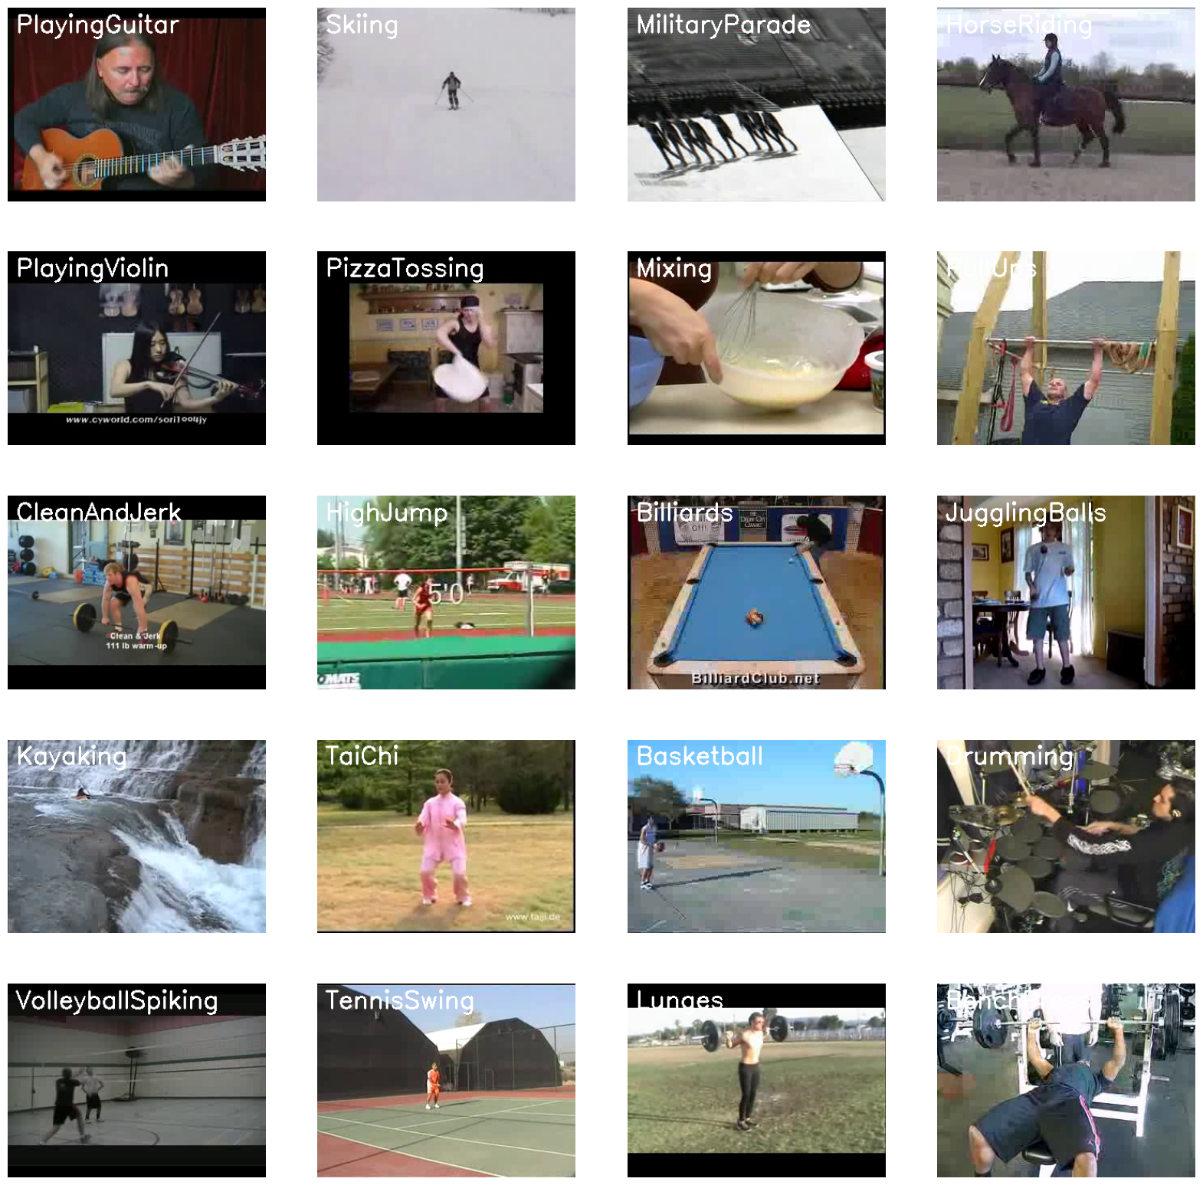
Vishwakarma Institute of Technology, Pune
MAJOR PROJECT
Heuristic Based Optimized classifier for HAR
Presented By:
Swapnil patil(33)
Devyani Ushir(41)
Guided By: Prof. Milind Kamble

Slide 2
Introduction
Literature Survey
Research Gap
Novelty
Methodology
Results
Advantages and Limitations
Conclusion
Contents

Slide 3
PROBLEM STATEMENT
Enhancing the accuracy of human activity recognition (HAR) in real-world settings using an optimized deep learning model that combines CNN and LSTM, with a specific focus on optimizing a ConvLSTM model using Particle Swarm Optimization (PSO) as a classifier For enhanced accuracy.
Notes:
developing a deep learning model that can accurately classify and recognize human actions in videos using a large video dataset. The challenge is to create a model that can handle the sequential nature of human actions, while also being able to capture the spatial and temporal features of the video data. The goal is to create a robust and accurate system that can be used for a variety of applications, such as video surveillance, human-robot interaction, and sports analysis. The effectiveness of the model will be evaluated based on its accuracy in recognizing human actions from a test dataset that contains videos of previously unseen human actions.

Slide 4

OBJECTIVES
The primary aim of this study is to optimize convLSTM model using Particle Swarm Optimization (PSO) as a classifier to significantly increase the accuracy of human activity recognition in real-world scenarios.
This involves leveraging a substantial video dataset to enhance model performance and robustness.
Notes:
To develop an accurate and efficient deep learning model for human action recognition using LSTM and CNN architectures.
To preprocess and prepare a large video dataset that contains a diverse range of human actions, captured from various viewpoints and in different environments.
To design a network architecture that can capture the spatial and temporal features of the video data and handle the sequential nature of human actions.
To train the deep learning model on the prepared video dataset to learn the relevant features and classify the human actions accurately.
To evaluate the effectiveness of the developed model on a test dataset that contains videos of previously unseen human actions and compare its performance with existing state-of-the-art models.

Slide 5

INTRODUCTION
Human activities Recognition is an important area of computer vision research and application .
Our study tackles the task of recognizing diverse human activities in real-world settings using deep learning techniques.
We enhance the accuracy of our deep learning model for classifying human actions in videos.
Notes:
Human action recognition is an important research area in computer vision and deep learning, with numerous practical applications in fields such as surveillance, human-robot interaction, sports analysis, and healthcare. The ability to accurately classify and recognize human actions in videos can provide valuable insights into human behavior and can be used for various decision-making tasks, such as anomaly detection, event recognition, and activity forecasting.
In recent years, deep learning techniques, particularly LSTM (Long Short-Term Memory) and CNN (Convolutional Neural Network) architectures, have shown promising results in human action recognition from video datasets. These techniques can capture the spatial and temporal features of the video data and handle the sequential nature of human actions, making them well-suited for this task.
In this project, we aim to develop a deep learning model using LSTM and CNN architectures for human action recognition from videos. We will preprocess and prepare a large video dataset that contains a diverse range of human actions, captured from various viewpoints and in different environments. We will design a network architecture that can capture the relevant features of the video data and classify the human actions accurately. We will train and evaluate the developed model on the prepared video dataset and compare its performance with existing state-of-the-art models. Finally, we will explore the potential applications of the developed model in real-world scenarios and contribute to the field of computer vision and deep learning for human action recognition.

Slide 6
LITERATURE SURVEY

Slide 7
A Novel Feature Selection Method for Video-Based Human Activity Recognition
[1]
Amjad ali et al. introduces a new feature selection methodology called the normalized mutual information-based feature selection for identification algorithms.
Experimental evaluations show the method outperforms alternative methods by 98%, despite dataset limitations
Human action recognition using genetic algorithms and convolutional neural networks
[2]
C.Krishna et al. researched a method for human action recognition using genetic algorithms and deep convolutional neural networks, demonstrating that initializing weights using a Generalized Adversarial minimizes classification errors and achieves recognition accuracy of 99.98%
Particle Swarm Optimization: A Comprehensive Survey
3]
This paper reviews Particle Swarm Optimization , a widely-used algorithm, highlighting its performance issues and potential enhancements through parameter modification, hybridization, cooperation, and multi-swarm techniques, highlighting its robustness and potential engineering applications.

Slide 8
Particle Swarm Optimization Algorithm and Its Applications: A Systematic Review
[4]
Ahmed G. Gad presents a reviews 2,140 Particle Swarm Optimization (PSO) methods and applications, revealing the general approach dominates industrial, environmental, smart city, healthcare, and commercial applications, with electrical engineering approaches having the highest.
The Applications of Metaheuristics for Human Activity Recognition
[5]
Ahmed m helmi et al. discusses the use of metaheuristics optimization algorithms in fall detection the use of sensor data.
The study used seven datasets and extensive experiments using SVM and RF classifiers.
Particle Swarm Optimization of Convolutional Neural Networks for Human Activity Prediction
[6]
The study explores the applications of HAR in various fields, particularly Sensor Based and aims to optimize parameters for generalization to other activity recognition tasks.
The PSO-CNN algorithm achieved an accuracy of 93.64%, with SVM being the best classifier.

Slide 9
Particle Swarm Optimization With Probability Sequence for Global Optimization [7] Umar Shoaib et al. introduces a new method for initializing populations in Particle Swarm Optimization using probability distribution. The results show the perfectness and dominance of WI-PSO, outperforming other methods for training with ANN classifiers.
Particle Swarm Optimization: Basic Concepts, Variants and Applications in Power Systems
[8]
The paper provides an overview of PSO's basic concepts and applications in power systems-based optimization problems.
PSO is an alternative solution for power systems, as classical analytical approaches may not be feasible due to the curse of dimensionality.

Slide 10
Late Fusion Approach
Early Fusion Approach
Research Gap
Using Pose Detection and LSTM
CNN + LSTM (convLSTM)
Model
CNN+LSTM(convLSTM)
With Partial Swarm Optimization.
Notes:
Single-Frame Classification
The simplest and most basic way of classifying actions in a video can be using an image classifier on each frame of the video and classify action in each frame independently. The classifier predicts Falling in some frames instead of Backflipping because this approach ignores the temporal relation of the frames sequence. And even if a person looks at those frames independently he may think that the person is Falling.
Late Fusion
Another slightly different approach is late fusion, in which after performing predictions on each frame independently, the classification results are passed to a fusion layer that merges all the information and makes the prediction. This approach also leverages the temporal information of the data.
Convolutional Neural Network (CNN)
A Convolutional Neural Network (CNN or ConvNet) is a type of deep neural network that is specifically designed to work with image data and excels when it comes to analyzing the images and making predictions on them.
Early Fusion
Another approach of video classification is early fusion, in which all the information is merged at the beginning of the network, unlike late fusion which merges the information in the end. This is a powerful approach but still has its own limitations.
Using Pose Detection and LSTM
Another method is to use a pose detection network on the video to get the landmark coordinates of the person for each frame in the video. And then feed the landmarks to an LSTM Network to predict the activity of the person.
CNN + LSTM
We will be using a CNN to extract spatial features at a given time step in the input sequence (video) and then an LSTM to identify temporal relations between frames. The two architectures that we will be using to use CNN along with LSTM are:
ConvLSTM
LRCN

Slide 11
Real
Optimized convLSTM model using
PSO
Novelty
Confidence rate of Action
Prediction is > 90 %
Use of USF50 dataset
Improved Results and Accuracy

Slide 12
METHODOLOGY

Slide 13
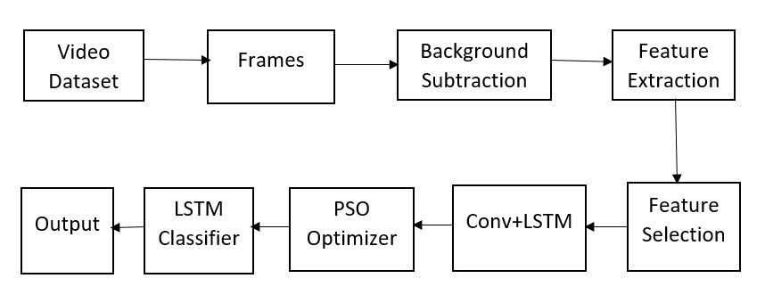
System Block Diagram

Slide 14

Dataset Collection
Clarity Dataset Creation
UCF50 Dataset, 50 Actions
Extension of YouTube dataset, 11 Action Categories
Provide the computer vision community
For all the 50 categories, the videos are grouped into 25 groups per Action Categories
Fig.1. Dataset Creation

Slide 15
Functional Diagram :
Download and Extract UCF50 Dataset
Random Frame Visualization
PSO Hyperparameter Optimization Function
Find the Best Hyperparameter and create Model
Create convLSTM Model
Data Pre-Processing
Model Training on Best Hyperparameter created Model
Model_Evaluation
Model Saved
Notes:
Here is the flow diagram of our proposed system so we have convert our images to HSV (hue, saturation, value) It is a color space that represents colors based on these three dimensions. Hue represents the color itself, such as red, blue, green, etc. Saturation represents the intensity or purity of the color, and value represents the brightness of color Then next we have set a threshold for lower and upper bound 40 40 40 for lower green and 70 255 255 for upper green then we have performed morphological operation. Morphological operations are often performed on binary images, The main purpose of the morphological opening operation is to remove small or isolated areas in the binary mask next we have drawing the contours of the vegetation zone to evaluate the vegetation area then we have done a segmentation . A method used in image processing to separate objects or regions according to their color or hue is called color-based segmentation this way we have find a final result of segmentation and calculation of its area and perimeter for analyzing the changes.

Slide 16
Accuracy
A = 𝑇𝑃 +TN / 𝑇𝑃 +TN +𝐹P +FN
Recall
R = 𝑇𝑃 / 𝑇𝑃 + 𝐹𝑁
Precision
P = 𝑇𝑃 / 𝑇𝑃 + 𝐹P
F-Score
F-Score = 𝑇𝑃 / 𝑇𝑃 + ½(FP +FN)
Performance Metrics
Classification and Analysis:

Slide 17
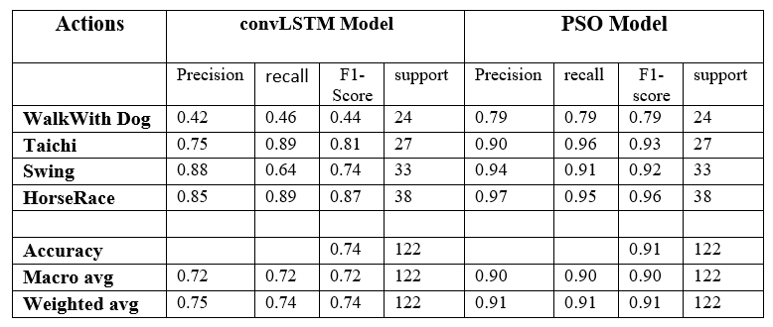
Performance Evaluation of
convLSTM VS convLSTM With PSO
Performance Metrics
Classification

Slide 18
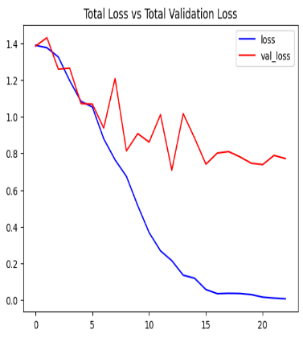
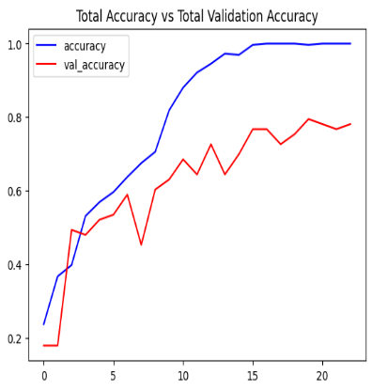
Results
Total loss vs total validation loss
Total Accuracy vs Total validation Accuracy

Slide 19
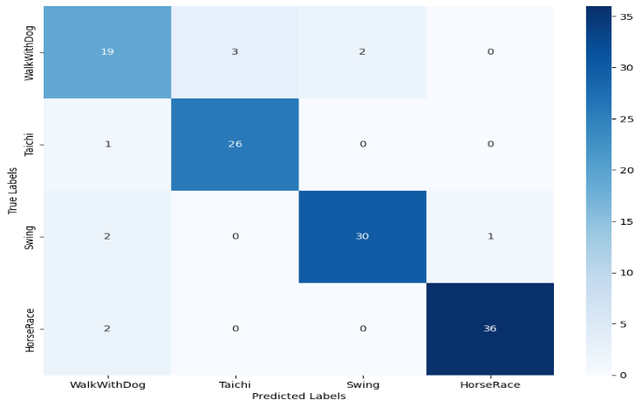
Results
Confusion matrix of PSO Model

Slide 20
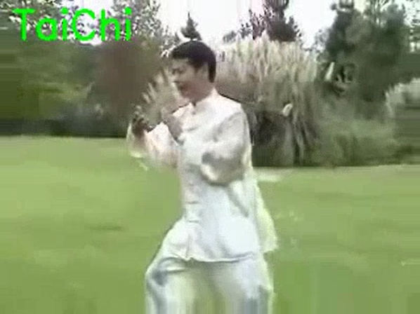
Results
Output 1 of HAR System
Output 2 of HAR System

Slide 21
Advantages
Limitations
Calculate a predictive model that can recognize a person ‘s activity.
Discover Activity patterns
Helps to improve accuracy
Analyze the activity of a person from the information collection by different devices
Not take Multiple views

Slide 22
In this study, we tackled the complex challenge of human activity recognition (HAR) in real-world scenarios using deep learning. Our primary objective was to optimize a deep learning model, specifically a combination of LSTM and CNN, with the incorporation of Particle Swarm Optimization (PSO).
We addressed the need for robust HAR systems capable of accurately recognizing a wide range of human activities, both simple and complex, within video data. By leveraging a substantial video dataset, we developed a model that demonstrated significant improvements in accuracy and performance.
Conclusion
Notes:
Need of Activity recognition for monitoring and surveillance , video segmentation etc is of growing demand in which this system can greatly help.

Slide 23
References:
[1]. Siddiqi, Muhammad Hameed, Madallah Alruwaili, and Amjad Ali. "A novel feature selection method for video-based human activity recognition systems." IEEE Access 7 (2019): 119593-119602.
[2]. Ijjina, Earnest Paul, and Krishna Mohan Chalavadi. "Human action recognition using genetic algorithms and convolutional neural networks." Pattern recognition 59 (2016): 199-212.
[3]. Mishra, Soumya Ranjan, Tusar Kanti Mishra, Anirban Sarkar, and Goutam Sanyal. "PSO based combined kernel learning framework for recognition of first-person activity in a video." Evolutionary Intelligence 14 (2021): 273-279.
[4]. Khatiwada, Pankaj, Ayan Chatterjee, and Matrika Subedi. "Automated human activity recognition by colliding bodies optimization-based optimal feature selection with recurrent neural network." arXiv preprint arXiv:2010.03324 (2020).
[5]. Viswambaran, Ramya Anasseriyil, Gang Chen, Bing Xue, and Mohammad Nekooei. "Evolutionary design of recurrent neural network architecture for human activity recognition." In 2019 IEEE Congress on Evolutionary Computation (CEC), pp. 554-561. IEEE, 2019.
[6]. Yu, Shilong. "Residual learning and LSTM networks for wearable human activity recognition problem." In 2018 37th Chinese Control Conference (CCC), pp. 9440-9447. IEEE, 2018.

Slide 24
[7]. Shami, Tareq M., Ayman A. El-Saleh, Mohammed Alswaitti, Qasem Al-Tashi, Mhd Amen Summakieh, and Seyedali Mirjalili. "Particle swarm optimization: A comprehensive survey." IEEE Access 10 (2022): 10031-10061.
[8]. Huang, Y., Yang, H., & Huang, P. (2012, March). Action recognition using hog feature in different resolution video sequences. In 2012 International Conference on Computer Distributed Control and Intelligent Environmental Monitoring (pp. 85-88). IEEE.
[9]. Gad, Ahmed G. "Particle swarm optimization algorithm and its applications: a systematic review." Archives of computational methods in engineering 29, no. 5 (2022): 2531-2561.
[10]. Basak, Hritam, Rohit Kundu, Pawan Kumar Singh, Muhammad Fazal Ijaz, Marcin Woźniak, and Ram Sarkar. "A union of deep learning and swarm-based optimization for 3D human action recognition." Scientific Reports 12, no. 1 (2022): 5494.
[11]. Al-Qaness, Mohammed AA, Ahmed M. Helmi, Abdelghani Dahou, and Mohamed Abd Elaziz. "The applications of metaheuristics for human activity recognition and fall detection using wearable sensors: A comprehensive analysis." Biosensors 12, no. 10 (2022): 821.
[12]. Devarakonda, Preethi Gunishetty, and Bojan Bozic. "Particle swarm optimization of convolutional neural networks for human activity prediction." In Optimisation Algorithms and Swarm Intelligence. IntechOpen, 2022.

Slide 25

PUBLICATION

Slide 26
THANK YOU
Notes:
Swapnil – 4 10 13 15 18 19
Devyani - 3 5 7 8 9 11 14 16 17 20 21 22

